Slide 1
Postpartum Care

Slide 2
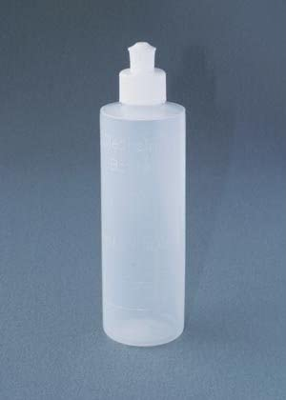
Perineal Care
Ice packs
Sitz bath
Peri bottle
Wipe front to back
Change your pad every time you urinate
Witch hazel and Tucks pads

Slide 3
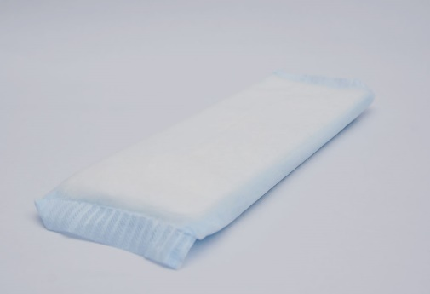
Postpartum Bleeding
Discharge can last up to 6 weeks
Pelvic rest for 6 weeks
Call if soaking a pad in 1 hour or clots are bigger than a ping pong ball

Slide 4
Medications
Ibuprofen, Acetaminophen, Percocet, or Vicodin for pain
Stool softener
Pain medications can cause constipation
Prenatal vitamins

Slide 5
Going Home
Car seat- atimmermancpst@gmail.com becca.peterson.cpst@gmail.com
Order your to go lunch
Public Health Nurse home visit
Lactation support

Slide 6
Weight Loss
Lose 10-15 lbs. after delivery
Different rates for different people
Start with gentle exercises
Wait for 6 week check-up before resuming exercise routine

Slide 7
Breast Care for Non-Breastfeeding Mom
Supportive bra for 3-4 days
Cold compress every 15 minutes as needed
Clean, raw, cold, green cabbage leaves to help relieve swelling and discomfort

Slide 8
Other Changes to Your Body
Hair loss
Skin changes
Gums may bleed
Incontinence
Night sweats

Slide 9
Postpartum Emotions
Baby Blues
Postpartum Depression
Postpartum Psychosis

Slide 10
Adjusting to Parenting
Parenting is a BIG adjustment
Changing role of Mother
Changing Role of Father or Partner
Communication
Have confidence
It’s temporary

Slide 11
Family Planning and Sexual Relationships
Can resume intercourse after 6 week check-up
Both partners are physically and emotionally ready
Birth control options
Fatigue, emotions, and self-image
Keep your sense of humor and relax

Slide 12
Letting Others Help
Accept help
Expect disorganization
Accept change

Slide 13
Community Resources
Get involved
ECFE
MOPS
Le Leche League
Options for Women
Parent Aware and Facebook
WIC

Slide 14
Newborn Care
Educator Version

Slide 15
Sources
Use recommended reading materials
Call the nurse line with questions
Parenting has changed over time

Slide 16
Noses
Use saline drops to loosen congestion
Bulb syringe
Nose Freida

Slide 17
Bottoms
Diaper Creams
Vaseline
Cosmeticsinfo.org

Slide 18
Bottles and Pacifiers
Nipple size
Types
Wait about 4 weeks to introduce a bottle if you are breastfeeding
Steam bags

Slide 19
Medications
Acetaminophen
Ibuprofen
Dosages based on weight until around age 2
Dispensers
Pedialyte

Slide 20
Nail Care
Small clippers with larger handle
File

Slide 21
Fevers
Many different styles
Inexpensive ones work great
How to take a temperature
Tell your Doctor or nurse how you took the temperature and what the read out was

Slide 22
Swaddling and Crib Safety
Styles
Arms out vs in
Rolling
Childcare rules
Empty crib is best

Slide 23
Diapering
Safety
Disposable
Cloth
Meconium

Slide 24
Bathing
Sponge bath at first
Temperature of water
Styles of tubs
Keep baby warm

Slide 25
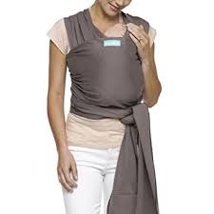
Baby wearing
TICKS
Styles
Ergonomic leg position

