Slide 1

Celebrate the life you are growing
Preparing your body by
easing your mind
2 Night Format

Slide 2
Welcome to Childbirth Class
Our goals for class:
Overview of the process of labor and delivery
Connect with your support person
Discover options available for your child’s birth
Book and folder

Slide 3
Introductions
Estimated due date
Doctor
Gender of the baby if you want to share

Slide 4
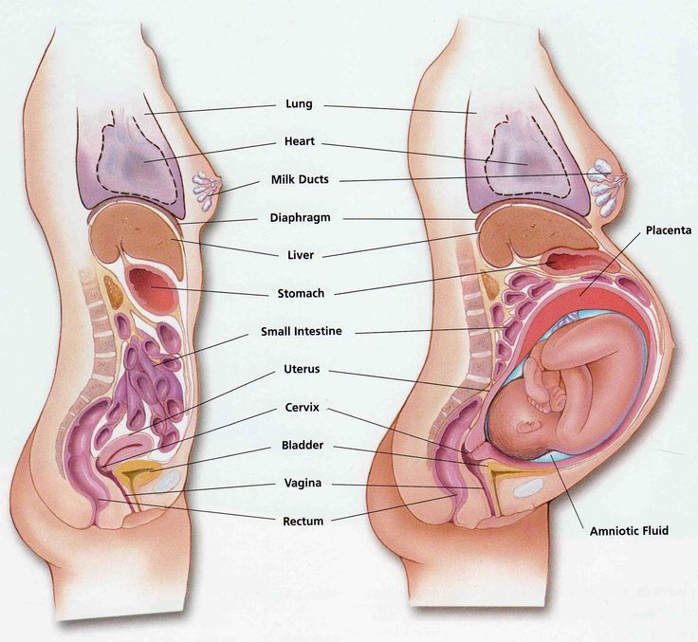
Anatomy of pregnancy

Slide 5
Dilation and effacement
Dilation is measuring the opening of the cervix around the baby’s head. Measured in centimeters from 1- 10.
Effacement is the thinning of the cervix. It is measured in percentages from 0-100 percent.
Station is how far your babies head has descended into your pelvis. -4 is high and +4 is ready to deliver.

Slide 6
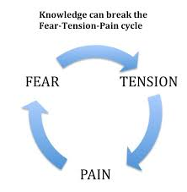
How is labor pain different than other pain?
Not caused by injury or illness
Intensifies gradually
Comes and goes

Slide 7
True vs Warm- Up Contractions
Eventually tighten the uterus
Usually cause pressure on lower back or belly
Last longer over time
Become stronger over time
Grow closer together
Do not stop when you change activity
Cause the cervix to thin and open
Tighten portions of the uterus
Don’t usually cause back pressure
Ease up over time
Lose intensity over time
Have no regular pattern
May stop when you rest or change positions
Do not cause the cervix to change

Slide 8
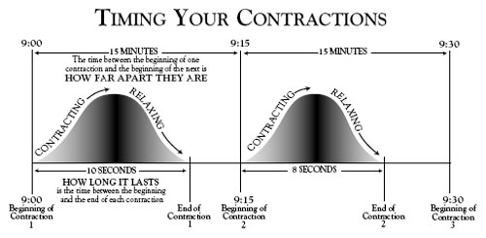
Timing contractions
Start to start
Smartphone apps

Slide 9
Preterm labor
Contractions
Cramps that feel like your period
Low, dull backache
Pelvic pressure
Change in vaginal discharge
Your water breaks in a trickle or gush
Any signs of labor before 37 weeks, call your provider or hospital!

Slide 10

Labor starts when you and your baby are ready!

Slide 11

Early labor
Flu-like symptoms
Menstrual-like cramps
Backache that comes and goes
Mild contractions that become closer together
Diarrhea
Just feeling “off”

Slide 12
Early labor
Have an early labor plan
How to give some comfort to Mom
  Popsicle hand massage
  Deep, cleansing breath
  “Relax” shoulder press

Slide 13
Going to the hospital
When to go
  5-1-1 (5 minutes apart, lasting for 1 minute, for 1 hour)
  Water breaks
  Excessive pain or bleeding
What to do
  Call Labor and Delivery at 507-594-2667
Where to go
  Enter through the Emergency Department
What to bring
  Packing list

Slide 14
When you arrive in your room
You will change into a gown or your laboring clothes
Hep lock or IV
Monitors
Then settle in!

Slide 15
Active labor
Strong contractions with regular progress from 6-8cm
Contractions are 3-5 minutes apart
Labor land
Actively breathing through each contraction
Hot
Often times membranes are ruptured
Usually lasts 3-5 hours
Birth plan for the hospital

Slide 16
Transition
8-10cm
Trembling
Fatigue
Nausea
Mom is more emotional
Contractions are 1-3 minutes apart
Usually lasts about 1 hour

Slide 17
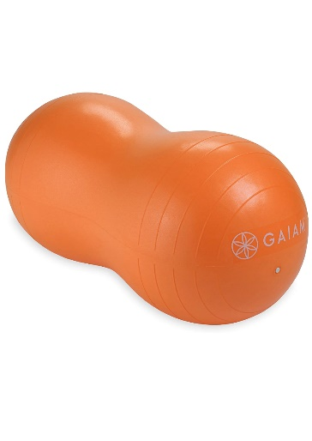
Movement and Positions
Birth ball
Counter pressure
Hip squeeze
Positions
Movement with and Epidural
Back labor
Relaxation and visualization

Slide 18

Pushing
Dilated to 10 centimeters
Strong urge with lots of pressure
Relief, excitement
Lots of ice and cold washcloths
Moms need lots of support
“Laboring down”
Pah Pah breathing
Guided pushing

Slide 19
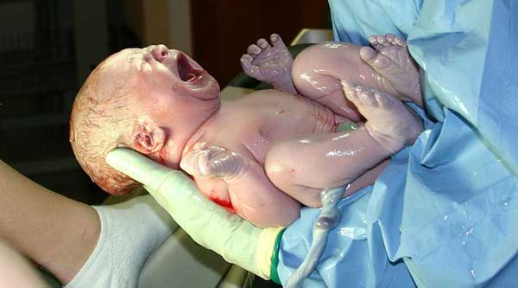
Birth
Your doctor arrives
Cutting the cord
Skin to skin with baby
Delivery of placenta

Slide 20

Celebrate your beautiful new baby

Slide 21
Labor Movie

Slide 22

Hospital Virtual Tour!
!

Slide 23
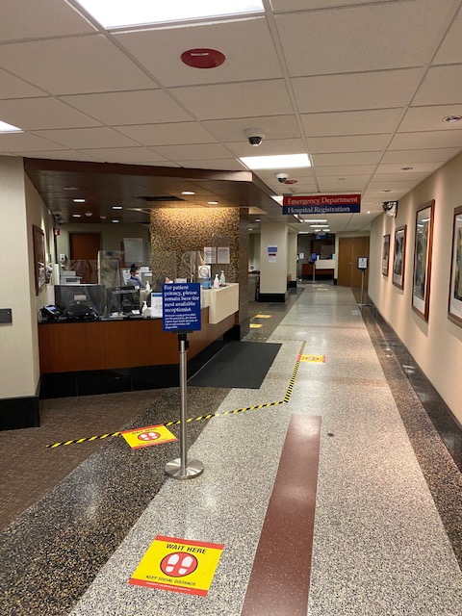
Registration Desk
Stop at the desk and give them your name and let them know why you are here (i.e. your water broke, you’re contracting, etc)

Slide 24
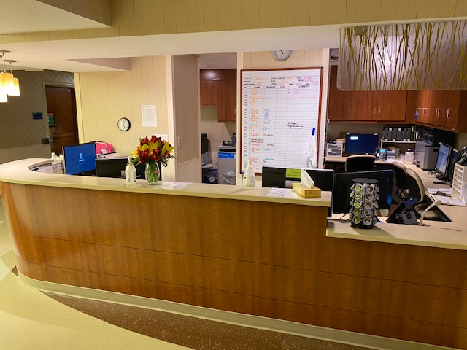
Main 5th Floor Nurses Station
ALL Visitors sign in here.

Slide 25
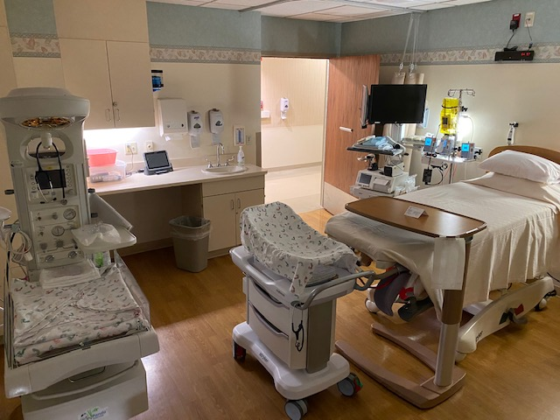
Labor and Delivery Room

Slide 26
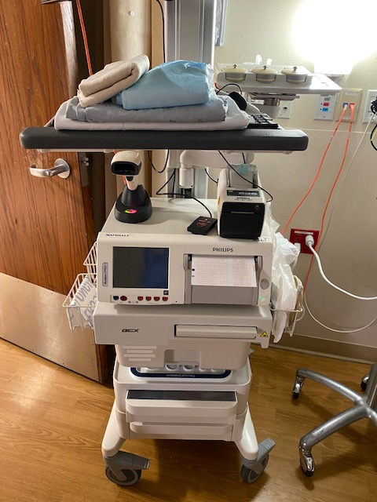
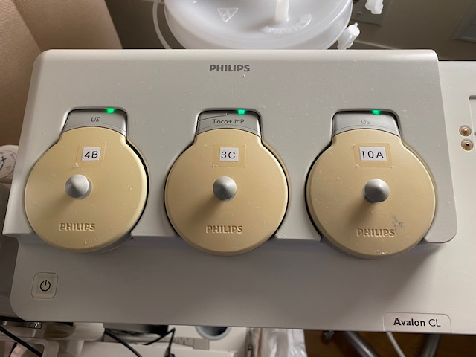
Monitoring

Slide 27

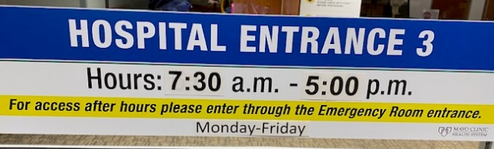
Entrance #3
This entrance can be used during the day, but locks in the evening.

Slide 28
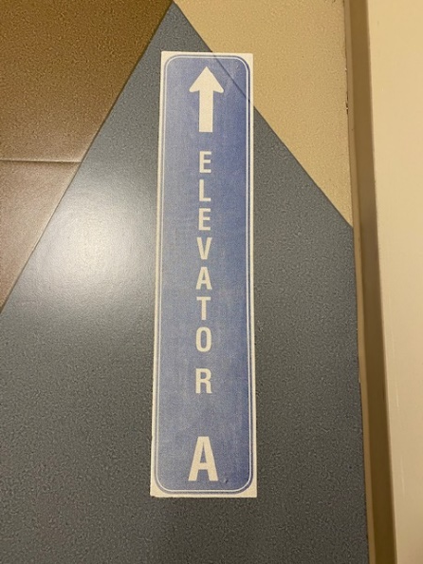
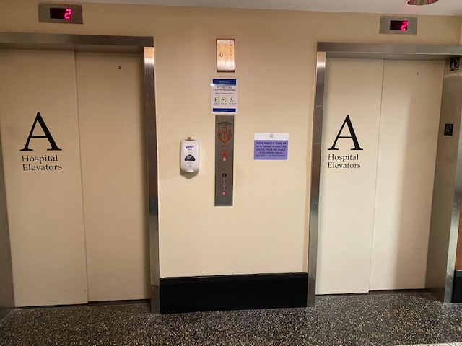
Elevator A
-You will use this elevator to go to/from the floor.
-You may also use it to visit the cafeteria on 2nd floor or the convenience room on 1st floor.

