Slide 1
Introduction to breastfeeding

Slide 2
                Babies should be breastfed and/or receive expressed human milk exclusively for the first six months of life. Breastfeeding should continue with the addition of complementary foods throughout the second half of the first year.
                - The American Academy of Pediatrics

Slide 3
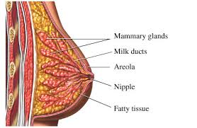
Anatomy of the breast

Slide 4
Your body is getting ready
Darkening of the areola
Growth of the breast
Increased circulation

Slide 5
Baby is Getting Ready
Sucks thumb
Prefers circles to squares
Sees contrast, light vs. dark
Knows mother’s smell

Slide 6
Colostrum
Thick, yellowish liquid
First 48-72 hours
Gives baby antibodies to protect your baby from infections

Slide 7
Amazing Milk
Your milk is made perfectly for your child
Always clean
Caregiver friendly stools
Always the right temperature
Natural tranquilizers

Slide 8
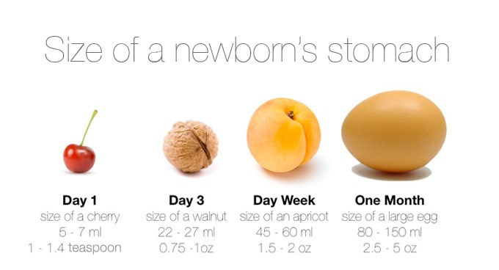
The First Week
From colostrum to milk
  Baby suckling stimulates milk
  Milk comes in 3-4 days postpartum
  Breasts may leak
  Breasts feel full with possible engorgement
  Baby swallows more

Slide 9
Breastfeeding Benefits for Baby
Less spit up, gas, diarrhea, and constipation
Healthier from the start
Stronger immune system
Better vision
Lowers the risk of Sudden Infant Death Syndrome (SIDS)

Slide 10
Breastfed Babies are Fit for Life
Fewer allergies, eczema, and asthma
Lowers the risks of leukemia, diabetes, and heart disease
Less likely to become obese as adults

Slide 11
Breastfeeding Benefits for Mom
Less postpartum bleeding
Lowers the risk of anemia
Increased caloric intake
Produces naturally soothing hormones
Lessens the risk of osteoporosis
Lowers the risk of breast, ovarian, and uterine cancers
Delays menstruation

Slide 12
Partners are Nurturing Too
Take care of mom
Help with the breastfeeding routine
Help with household responsibilities
Develop unique and special bond with baby
Introduce a bottle after nursing is well established, at least 3-4 weeks

Slide 13
Happy Birthday Baby!
Imagine the baby’s birth from the baby’s point of view
  Cold
  Bright
  Noisy
Bring the baby back to mom to help the baby with transition to the outside world
The less separation of mom and baby, the better

Slide 14
Get Off to a Good Start
Right after birth baby is most alert
Early and frequent skin-to-skin contact
Allow the baby to:
  Touch the breast
  Taste the colostrum
  Attempt to latch

Slide 15
Benefits of Skin to Skin
Allows mom to see feeding cues
Increases milk production
Decreases crying and provides comfort
Regulates baby’s heart rate, temperature, and blood sugar
Increases baby/caregiver bonding

Slide 16
Nursery nest
Pillows or boppy
Water/snacks
Reading material
Remote and phone
Nursing pads
Diapering supplies
Nail file
Burp cloth
Receiving blanket

Slide 17

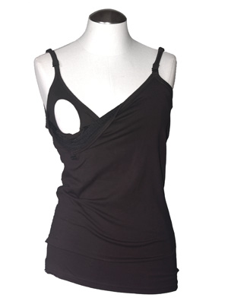
Helpful breastfeeding clothing
Nursing bra
Nursing tank
Cover-up

Slide 18
Hunger Cues
Rooting, turning head toward the breast
Sucking on hand or thumb
Smacking lips
Tongue movements
Restlessness
Crying

Slide 19
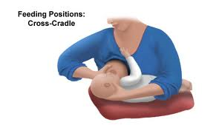
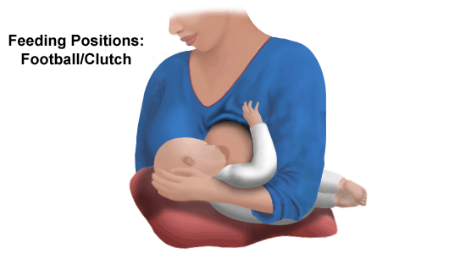


Positions

Slide 20
Latching Baby
Important for mom’s comfort
Important for milk supply
Use pillows to position baby
Check lips and tongue position
Avoid pulling on nipple
Break latch when painful

Slide 21
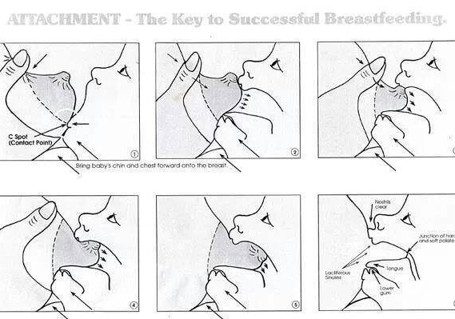

Slide 22
A Typical Feeding
Look for hunger cues
Latch baby on fullest side
Burp baby, offer second side
Baby will nurse for 10-45 minutes
Feed on demand

Slide 23
Milk Production Tips
Supply and demand
  The more the baby nurses, or the more you pump, the more milk you will make
  Stay hydrated
  Supplemental or bottle feedings will decrease your milk supply, especially in the early weeks
  Watch the baby not the clock
  Go everywhere with your baby

Slide 24
Signs Baby is Getting Enough
Baby will:
  Nurse 10-45 minutes per feeding
  Nurse 8-12 times in 24 hours
  Have 6-8 wet diapers and 3-4 stools in 24 hours
Mom will
  Hear swallowing
  Breasts will feel softer
  Change a lot of diapers
  Have the baby weighed if there are concerns

Slide 25
What Can be Done if it Hurts?
Home cures
  Lanolin
  Soothies
  Breast milk
  Check latch and position

Slide 26
Call Lactation or your Doctor if you
Experience:
Pain
Bleeding
Flu-like symptoms
Fever
Frustration

Slide 27
Nighttime Feedings
Parents need sleep, too!
  Baby will nurse at night
  Utilize a co-sleeper or bassinette
  Nap when baby naps
  Feeding more during the day means feeding less at night
  Have partner give baby a bottle once nursing is established
  Establish an overnight routine utilizing both partners

Slide 28
Utilizing a Breast Pump
Not everyone will need a pump
Great if you are going back to work
Several different kinds of pumps
Educate yourself prior to purchase
Read the manual to use the pump efficiently

Slide 29
Pumping
Always feed your baby first and then pump
There is the most milk in the morning
Pump/express as many times as you would breastfeed baby while you are away from baby
Breastfeed once you are with baby again
Silicone milk collector

Slide 30
Storing Breastmilk
Avoid adding freshly pumped milk to already cooled milk
Freeze milk in small portions
Label containers with the date and baby’s name
Use oldest milk first

Slide 31
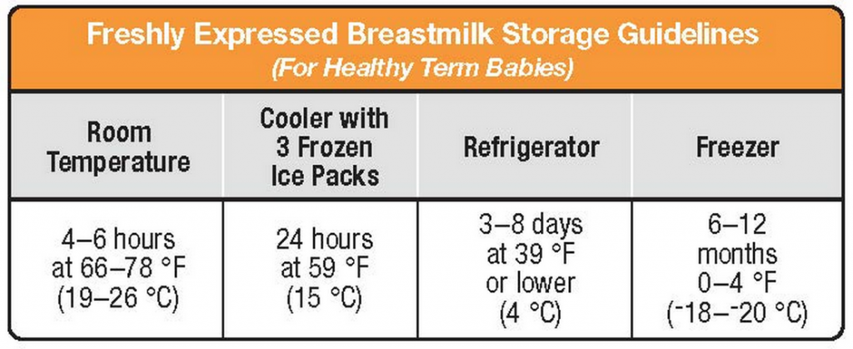
Milk Storage

Slide 32
Thawing Breastmilk
Thaw breastmilk in the container it has been stored in
Thaw overnight in the refrigerator or hold under/in warm water
Never use a microwave or hot water
Use thawed milk within 24 hours
Never refreeze thawed milk

Slide 33
Bottle Feeding
Paced bottle feeding
Hold baby upright so baby has control of flow
Alternate sides halfway through a feeding or with every other feeding
Use a slow flow nipple to mimic the breast
Burp after each feeding
Watch for feeding cues
Use this time to bond with baby

Slide 34
Medication and Foods
Avoid caffeine and alcohol
Eat a variety of foods to introduce the baby to new flavors
Acetaminophen, Ibuprofen, and Sudafed are all safe
Consult your doctor, pharmacist, or lactation consultant with questions

Slide 35
Common Problems in the First 6 Weeks
Not nursing enough
Feeding time is too short
Overuse of bottles and pacifiers
Poor latch
Associating normal newborn behaviors with breastfeeding problems

Slide 36
Find Support
Friends and family
Lactation consultants
Le Leche League
Online resources

Slide 37
Trust your Body, Trust your Baby
It can take up to six weeks to master breastfeeding
Be patient with yourself, trust yourself and your baby
Support is key
Every feeding is a gift of love
Relax

Slide 38
“A newborn baby has only three demands. They are warmth in the arms of its mother, food from her breasts and security in the knowledge of her presence. Breastfeeding satisfies all three.”
-Grantly Dick-Read

