Slide 1
Newborn care

Slide 2
What to do now:
Chose baby’s healthcare provider
Family Practice and Pediatric Providers
A few good books
Newborn supplies

Slide 3
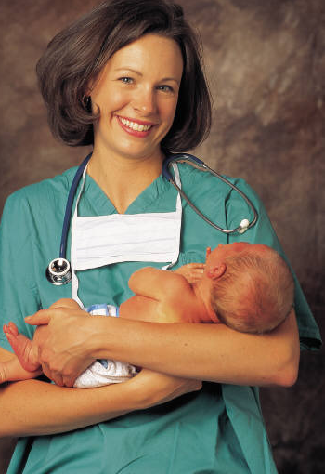
When a baby doctor attends delivery
Less than 37 weeks gestation
Emergency C-Section
Multiples
Hospitalist vs. Primary Provider

Slide 4
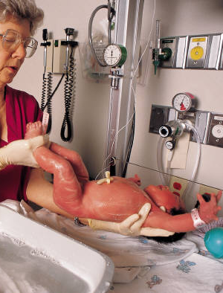
At birth
Skin to Skin time
Apgar checks at 1 minute and 5 minutes after birth
Baby’s temperature
Breastfeeding
If needed, baby care is done in the warmer

Slide 5
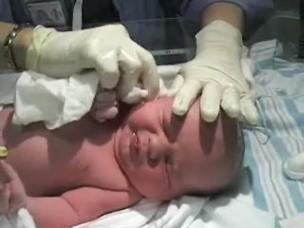
Other baby cares
Weight, height, and head circumference
Medications: Vitamin K shot, Hepatitis B shot, and eye ointment
Screening blood tests (heel stick) at 24 hours
Hearing test – performed usually first night
Jaundice

Slide 6
Circumcision
Pros and cons
Description of procedure
Timing of appointment
When
Where

Slide 7
Just in case
Occasionally, a newborn may need special attention the hospital in Mankato is not equipped to provide. The baby will be transferred to a neonatal unit at a different hospital for specialized care
If your baby would need to be transferred, Mankato Clinic Providers work closely with several area hospitals

Slide 8
Baby’s adjustment
Stools – meconium first
Sleeping
Responding to baby’s cries

Slide 9
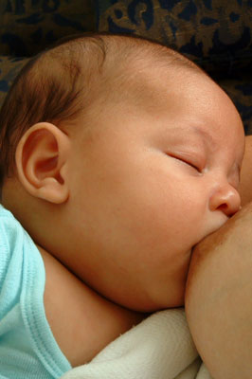
Feedings
Breast or bottle – both provide adequate nutrition
Babies need night feedings for at least the first 6 weeks
First feeding will usually be within the first hour after delivery, then usually every 2-3 hours during the first month of life
Babies should be fed on demand by paying attention to his/her signals

Slide 10
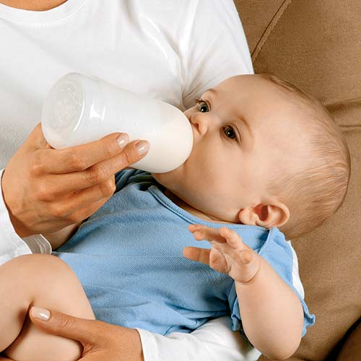
Feedings continued
Breast
Perfect nutrition, contains antibodies, protection from obesity, asthma and allergies
Health benefits for mom and baby
Inexpensive and always available
Bottle
Commercial formulas are very similar
Others can share in feedings more easily

Slide 11
Feedings continued
How to know if your baby’s getting enough
6 or more wet diapers per day
4 or more bowel movements (BMs) per day (may decrease to every 3-7 days after 4-6 weeks old)
Weight gain will be the best indicator

Slide 12
When to call the doctor
Fever more than 100.5°
Marked changes in eating
Very watery stools
Excessive sleepiness
Excessive irritability

Slide 13
First week of life visit
Call to schedule visit within 48 hours after birth
Newborn assessment
Lactation support for mom

Slide 14
Well child visits
These exams are important for growth, developmental milestones and immunizations
1st week of life
1 month
2 months
4 months
6 months
9 months
12 months
15 months
18 months
2 years
3 years
4 years
kindergarten

Slide 15
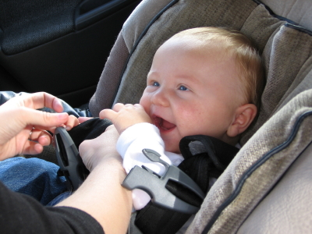
Safety for baby
Car seat – Car Seat Safety classes are offered through the Mankato Clinic Foundation
Keep baby away from second hand smoke
Never shake a baby
Back to sleep in an empty crib

Slide 16
Enjoying your newborn
You CANNOT spoil a baby by giving him/her too much attention!
Holding, talking and singing
Attend to baby’s needs
Reading
Seeking help when needed
Lots of love

Slide 17
Movie
5 S’s

